Slide 1

Cause of death
By:-Nupriya saxena
Filiprobo:-Internship-34

Slide 2

Cause of death world wide

Slide 3
Definitions: Cause of death vs risk factors
It is important to understand what is meant by the cause of death and the risk factor associated with a premature death:
In the epidemiological framework of the Global Burden of Disease study each death has one specific cause. In their own words: ‘each death is attributed to a single underlying cause — the cause that initiated the series of events leading to death’.²
This is different from the deaths that happened due to risk factors. These deaths are an estimation of the reduction of the number of deaths that would be achieved if the risk factors to which a population is exposed would be eliminated (in the case of tobacco smoking, for example) or reduced to an optimal, healthy level (in the case of body-mass index).

Slide 4
What do people die from?
56 million people died in 2017.³ What did they die from?
The Global Burden of Disease is a major global study on the causes of death and disease published in the medical journal The Lancet.⁴ These estimates of the annual number of deaths by cause are shown here.
This is shown for deaths worldwide. But you can explore data on the annual number of deaths by cause for any country or region using the “change country” toggle.
Non-communicable diseases (NCDs) not only dominate mortality figures at a global level, but also account for the majority of deaths in high-income countries.

Slide 5
Context
A straightforward way to assess the health status of a population is to focus on mortality – or concepts like child mortality or life expectancy, which are based on mortality estimates. A focus on mortality, however, does not take into account that the burden of diseases is not only that they kill people, but that they cause suffering to people who live with them. Assessing health outcomes by both mortality and morbidity (the prevalent diseases) provides a more encompassing view on health outcomes. This is the topic of this entry. The sum of mortality and morbidity is referred to as the ‘burden of disease’ and can be measured by a metric called ‘Disability Adjusted Life Years‘ (DALYs). DALYs are measuring lost health and are a standardized metric that allow for direct comparisons of disease burdens of different diseases across countries, between different populations, and over time. Conceptually, one DALY is the equivalent of losing one year in good health because of either premature death or disease or disability. One DALY represents one lost year of healthy life. The first ‘Global Burden of Disease’ (GBD) was GBD 1990 and the DALY metric was prominently featured in the World Bank’s 1993 World Development Report. Today it is published by both the researchers at the Institute of Health Metrics and Evaluation (IHME) and the ‘Disease Burden Unit’ at the World Health Organization (WHO), which was created in 1998. The IHME continues the work that was started in the early 1990s and publishes the Global Burden of Disease study.

Slide 6
Content
In this Dataset, we have Historical Data of different cause of deaths for all ages around the World. The key features of this Dataset are: Meningitis, Alzheimer's Disease and Other Dementias, Parkinson's Disease, Nutritional Deficiencies, Malaria, Drowning, Interpersonal Violence, Maternal Disorders, HIV/AIDS, Drug Use Disorders, Tuberculosis, Cardiovascular Diseases, Lower Respiratory Infections, Neonatal Disorders, Alcohol Use Disorders, Self-harm, Exposure to Forces of Nature, Diarrheal Diseases, Environmental Heat and Cold Exposure, Neoplasms, Conflict and Terrorism, Diabetes Mellitus, Chronic Kidney Disease, Poisonings, Protein-Energy Malnutrition, Road Injuries, Chronic Respiratory Diseases, Cirrhosis and Other Chronic Liver Diseases, Digestive Diseases, Fire, Heat, and Hot Substances, Acute Hepatitis.

Slide 7
Dataset Glossary (Column-wise)
01. Country/Territory - Name of the Country/Territory
02. Code - Country/Territory Code
03. Year - Year of the Incident
04. Meningitis - No. of People died from Meningitis
05. Alzheimer's Disease and Other Dementias - No. of People died from Alzheimer's Disease and Other Dementias
06. Parkinson's Disease - No. of People died from Parkinson's Disease
07. Nutritional Deficiencies - No. of People died from Nutritional Deficiencies

Slide 8
08. Malaria - No. of People died from Malaria
09. Drowning - No. of People died from Drowning
10. Interpersonal Violence - No. of People died from Interpersonal Violence
11. Maternal Disorders - No. of People died from Maternal Disorders
12. Drug Use Disorders - No. of People died from Drug Use Disorders
13. Tuberculosis - No. of People died from Tuberculosis
14. Cardiovascular Diseases - No. of People died from Cardiovascular Diseases

Slide 9
15. Lower Respiratory Infections - No. of People died from Lower Respiratory Infections
16. Neonatal Disorders - No. of People died from Neonatal Disorders
17. Alcohol Use Disorders - No. of People died from Alcohol Use Disorders
18. Self-harm - No. of People died from Self-harm
19. Exposure to Forces of Nature - No. of People died from Exposure to Forces of Nature
20. Diarrheal Diseases - No. of People died from Diarrheal Diseases
21. Environmental Heat and Cold Exposure - No. of People died from Environmental Heat and Cold Exposure

Slide 10
22. Neoplasms - No. of People died from Neoplasms
23. Conflict and Terrorism - No. of People died from Conflict and Terrorism
24. Diabetes Mellitus - No. of People died from Diabetes Mellitus
25. Chronic Kidney Disease - No. of People died from Chronic Kidney Disease
26. Poisonings - No. of People died from Poisoning
27. Protein-Energy Malnutrition - No. of People died from Protein-Energy Malnutrition
28. Chronic Respiratory Diseases - No. of People died from Chronic Respiratory Diseases

Slide 11
29. Cirrhosis and Other Chronic Liver Diseases - No. of People died from Cirrhosis and Other Chronic Liver Diseases
30. Digestive Diseases - No. of People died from Digestive Diseases
31. Fire, Heat, and Hot Substances - No. of People died from Fire or Heat or any Hot Substances
32. Acute Hepatitis - No. of People died from Acute Hepatitis

Slide 12
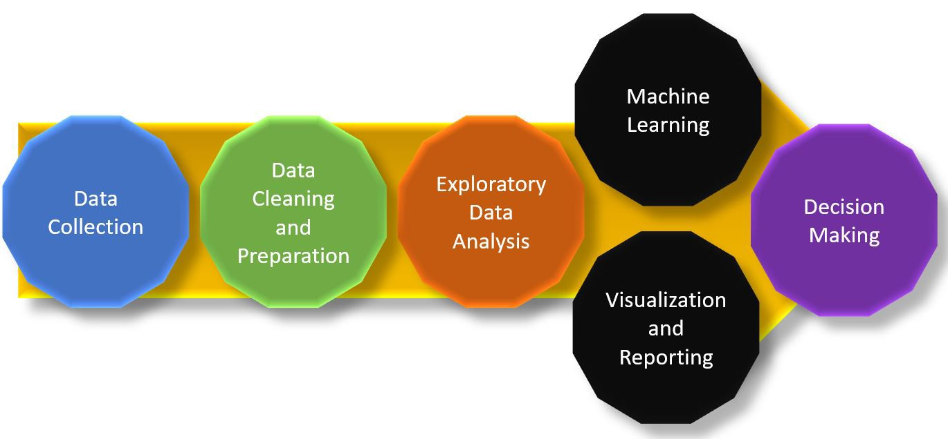
Project flow chart

Slide 13
Let's start exploring the dataset.

Slide 14
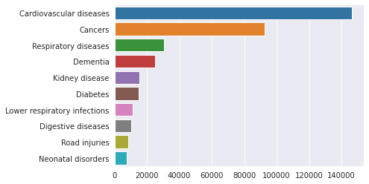
Top 10 causes of death for Turkey in the latest available year, 2017:

Slide 15
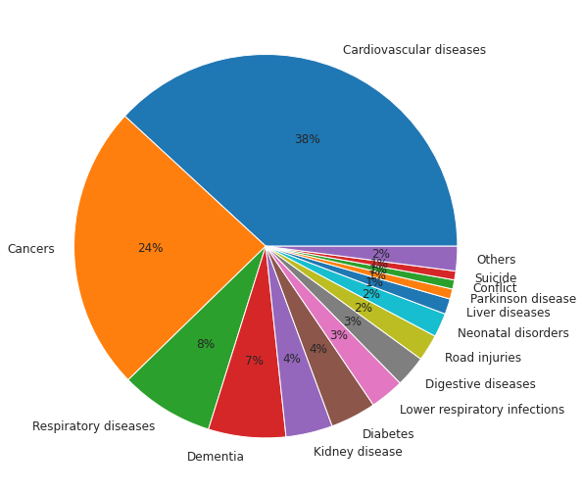
Almost 4 out 10 deaths in Turkey are caused by Cardiovasculare diseases in 2017

Slide 16
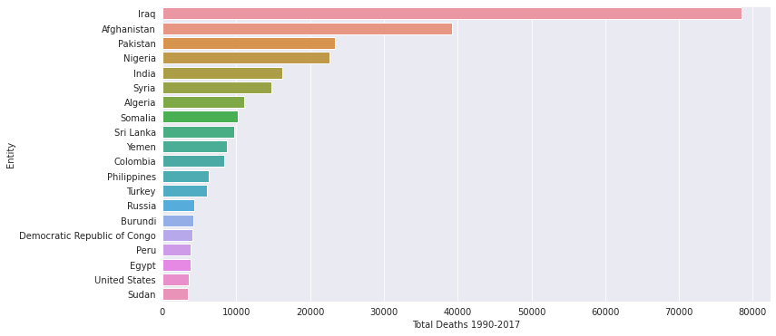
Top 20 countries which suffered from terrorism the most. Our dataset Entity column contains a mix of country, continent, region, territory information too such as Sub-Saharan Africa, South America etc

Slide 17
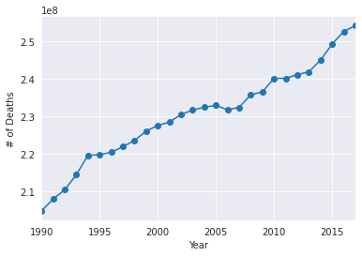
Deadliest year appears to be 2017, however this is due to the increase of the world population each year. We need to check death rate per year.

Slide 18
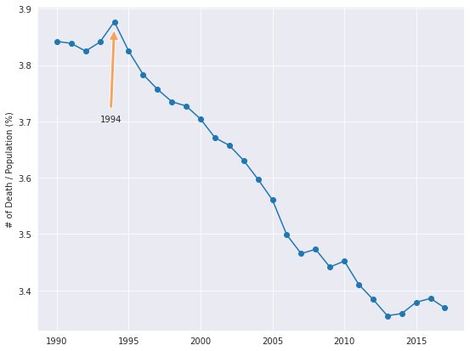
1994 was the deadliest year with almost 4% of the population was died

Slide 19
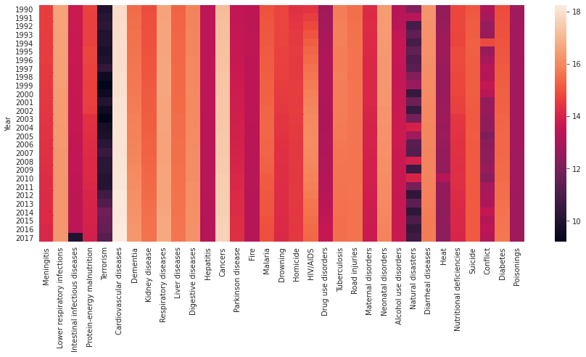
Conflict line of the heatmap shows an interesting light colour on year 1994

Slide 20
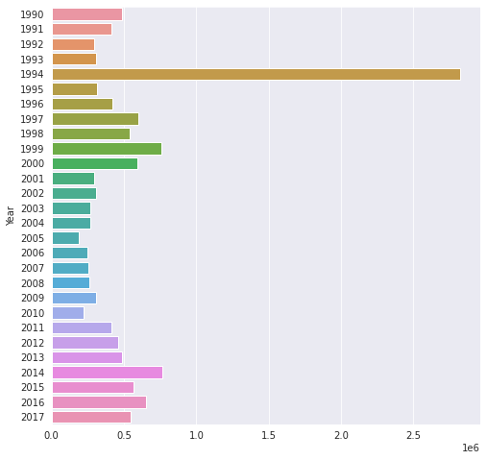
Conflict graph shows that 1994 was the year where the deadliest conflicts took place in the world.

Slide 21
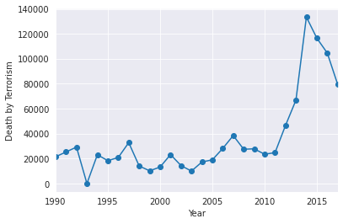
Death by terrorism peaked in 2014, and has been declining since then, however no effect was observed on 1994 death toll

Slide 22
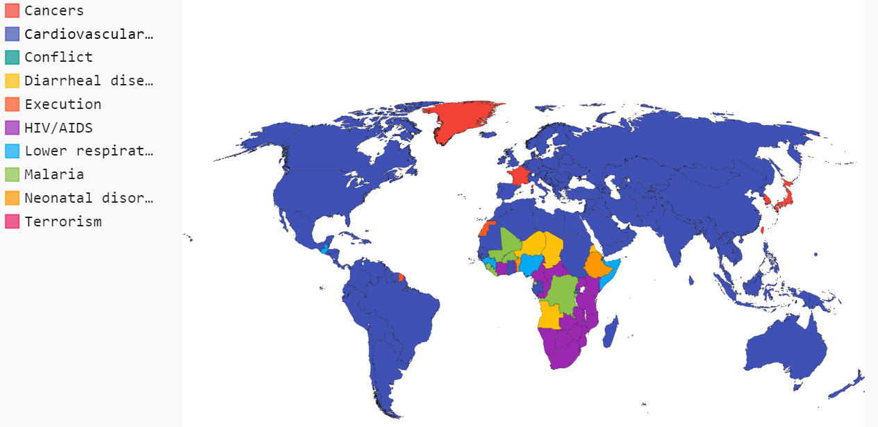
Let's find out which country suffers from what disease the most

Slide 23


